Slide 1
A Class Is a Type
A class is a special kind of programmer-defined type, and variables can be declared of a class type
A value of a class type is called an object or an instance of the class
If A is a class, then the phrases "bla is of type A," "bla is an object of the class A," and "bla is an instance of the class A" mean the same thing
A class determines the types of data that an object can contain, as well as the actions it can perform

Slide 2
Primitive Type Values vs. Class Type Values
A primitive type value is a single piece of data
A class type value or object can have multiple pieces of data, as well as actions called methods
All objects of a class have the same methods
All objects of a class have the same pieces of data (i.e., name, type, and number)
For a given object, each piece of data can hold a different value

Slide 3
The Contents of a Class Definition
A class definition specifies the data items and methods that all of its objects will have
These data items and methods are sometimes called members of the object
Data items are called fields or instance variables
Instance variable declarations and method definitions can be placed in any order within the class definition

Slide 4


The new Operator
An object of a class is named or declared by a variable of the class type:
The new operator must then be used to create the object and associate it with its variable name:
These can be combined as follows:

Slide 5
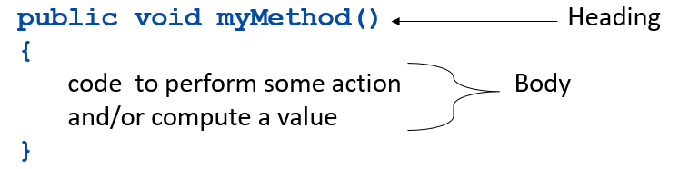

Instance Variables and Methods (2 of 2)
Method definitions are divided into two parts: a heading and a method body:
Methods are invoked using the name of the calling object and the method name as follows:
Invoking a method is equivalent to executing the method body

Slide 6
Main is a Void Method
A program in Java is just a class that has a main method
When you give a command to run a Java program, the run-time system invokes the method main
Note that main is a void method, as indicated by its heading:

Slide 7
Local Variables
A variable declared within a method definition is called a local variable
All variables declared in the main method are local variables
All method parameters are local variables
If two methods each have a local variable of the same name, they are still two entirely different variables

Slide 8
Global Variables
Some programming languages include another kind of variable called a global variable
The Java language does not have global variables

Slide 9
Blocks
A block is another name for a compound statement, that is, a set of Java statements enclosed in braces,{}
A variable declared within a block is local to that block, and cannot be used outside the block
Once a variable has been declared within a block, its name cannot be used for anything else within the same method definition

Slide 10
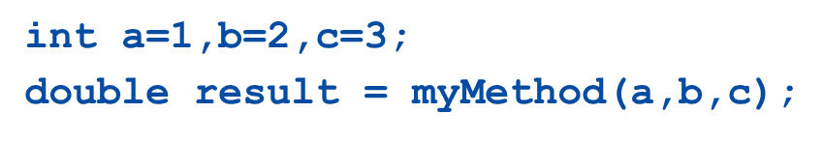
Parameters of a Primitive Type (3 of 6)
When a method is invoked, the appropriate values must be passed to the method in the form of arguments
Arguments are also called actual parameters
The number and order of the arguments must exactly match that of the parameter list
The type of each argument must be compatible with the type of the corresponding parameter

Slide 11
Parameters of a Primitive Type (4 of 6)
In the preceding example, the value of each argument (not the variable name) is plugged into the corresponding method parameter
This method of plugging in arguments for formal parameters is known as the call-by-value mechanism

Slide 12
The This Parameter (1 of 3)
All instance variables are understood to have
in front of them
If an explicit name for the calling object is needed, the keyword this can be used
myInstanceVariable always means and is always interchangeable with this.myInstanceVariable

Slide 13
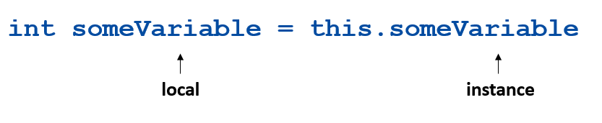
The This Parameter (2 of 3)
this must be used if a parameter or other local variable with the same name is used in the method
Otherwise, all instances of the variable name will be interpreted as local

Slide 14
The This Parameter (3 of 3)
The this parameter is a kind of hidden parameter
Even though it does not appear on the parameter list of a method, it is still a parameter
When a method is invoked, the calling object is automatically plugged in for this

Slide 15
Methods That Return a Boolean Value
An invocation of a method that returns a value of type boolean returns either true or false
Therefore, it is common practice to use an invocation of such a method to control statements and loops where a Boolean expression is expected
if-else statements, while loops, etc.

Slide 16
Accessor and Mutator Methods
Accessor methods allow the programmer to obtain the value of an object's instance variables
The data can be accessed but not changed
The name of an accessor method typically starts with the word get
Mutator methods allow the programmer to change the value of an object's instance variables in a controlled manner
Incoming data is typically tested and/or filtered
The name of a mutator method typically starts with the word set

Slide 17
Overloading
Overloading is when two or more methods in the same class have the same method name
To be valid, any two definitions of the method name must have different signatures
A signature consists of the name of a method together with its parameter list
Differing signatures must have different numbers and/or types of parameters

Slide 18
Constructors (1 of 2)
A constructor is a special kind of method that is designed to initialize the instance variables for an object:
A constructor must have the same name as the class
A constructor has no type returned, not even void
Constructors are typically overloaded

Slide 19
Constructors (2 of 2)
A constructor is called when an object of the class is created using new
The name of the constructor and its parenthesized list of arguments (if any) must follow the new operator
This is the only valid way to invoke a constructor: a constructor cannot be invoked like an ordinary method
If a constructor is invoked again (using new), the first object is discarded and an entirely new object is created
If you need to change the values of instance variables of the object, use mutator methods instead

Slide 20

The StringTokenizer Class
The StringTokenizer class is used to recover the words or tokens in a multi-word String
You can use whitespace characters to separate each token, or you can specify the characters you wish to use as separators
In order to use the StringTokenizer class, be sure to include the following at the start of the file:

Slide 21
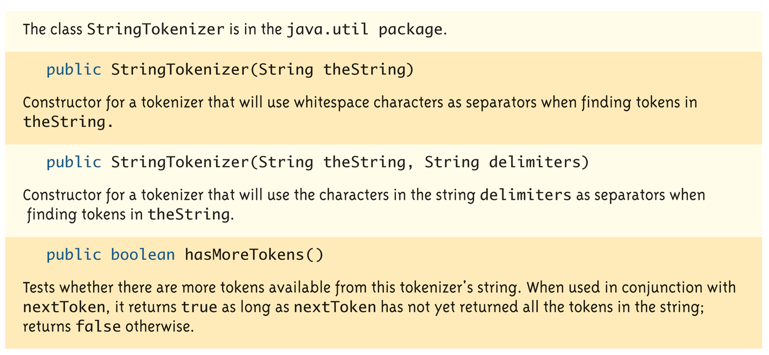
Some Methods in the StringTokenizer Class (1 of 2)
Display 4.17 Some Methods in the class StringTokenizer

Slide 22
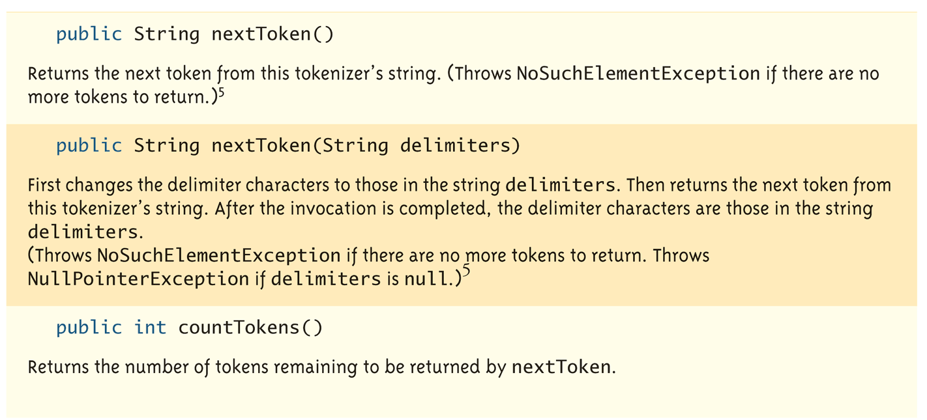
Some Methods in the StringTokenizer Class (2 of 2)
Display 4.17 Some Methods in the class StringTokenizer

